Slide 1

DEADLOCK SIMULATION
Avoidance · Detection · Recovery
OS Lab Project — 4th Semester | BS Cyber Security
NASTP IIT | Ms. Iqra Siddique
Muhammad Haseeb Sajid F2024CY018
Ali Muhammad F2024CY027
Hafiz Ahmed Riaz F2024CY005
Muhammad Ahmed F2024CY033
May 3, 2026

Slide 2









Presentation Outline
A structured walk-through of our Deadlock Simulation project
01
Problem Statement & Motivation
07
Recovery Strategies
02
System Architecture & Tech Stack
08
GUI Walkthrough & Features
03
Banker's Algorithm — Avoidance
09
Live Demo — Sample Test Case
04
Resource Request Handling
10
Algorithms in Code (C++/Qt)
05
Deadlock Detection Algorithm
11
Challenges & Learning Outcomes
06
Resource Allocation Graph (RAG)
12
Conclusion & Q&A

Slide 3
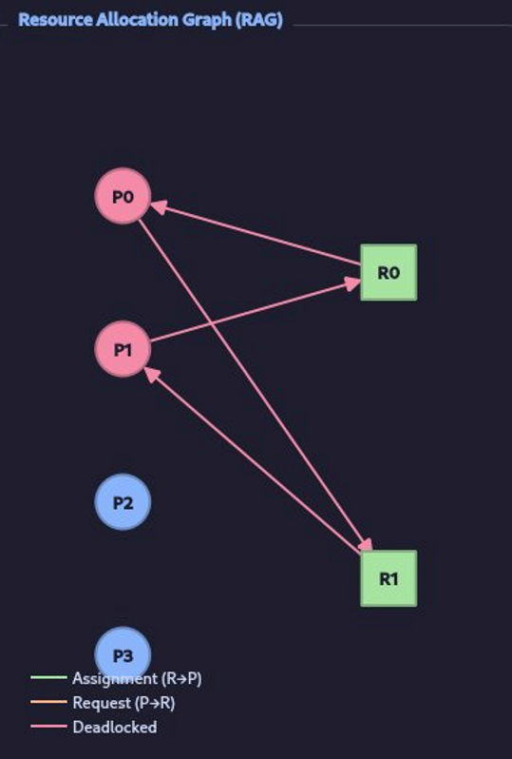
Problem Statement & Motivation
4
3
C++
Conditions
Strategies
Language
for Deadlock
Implemented
Qt5 GUI
Circular Wait — Deadlock Cycle
What is a Deadlock?
A deadlock is a state where a set of processes are permanently blocked,
each waiting for a resource held by another in the same set.
Coffman's 4 Necessary Conditions:
Mutual Exclusion · Hold & Wait
No Preemption · Circular Wait

Slide 4
System Architecture & Tech Stack
GUI Layer
Project Structure
Qt5 Widgets — MainWindow (3 tabs)
DeadlockSim/
├─ include/
│ ├─ Banker.h
│ ├─ Detection.h
│ ├─ Recovery.h
│ ├─ RAGWidget.h
│ └─ MainWindow.h
└─ src/
├─ main.cpp
├─ Banker.cpp
├─ Detection.cpp
├─ Recovery.cpp
├─ RAGWidget.cpp
└─ MainWindow.cpp
Algorithm Layer
Banker | Detection | Recovery
Visualisation
RAGWidget — QPainter custom widget
Data / State
Allocation · Available · Need · Request matrices
C++17
Qt 5.15
OOP
CMake / qmake

Slide 5
Banker's Algorithm — Deadlock Avoidance
Dijkstra's classic algorithm — grants requests only if the resulting state is provably safe
// Safety Check Pseudocode
Work ← Available[1..R]
Finish[i] ← false for all i
LOOP:
find i : Finish[i]=false
AND Need[i] ≤ Work
Work ← Work + Allocation[i]
Finish[i] ← true
END LOOP
if all Finish[i] = true
→ SAFE STATE ✓
else
→ UNSAFE STATE ✗
Sample Matrices (5 Processes, 3 Resources)
Process | Max (R0 R1 R2) | Alloc (R0 R1 R2) | Need (R0 R1 R2)
P0 | 7 5 3 | 0 1 0 | 7 4 3
P1 | 3 2 2 | 2 0 0 | 1 2 2
P2 | 9 0 2 | 3 0 2 | 6 0 0
P3 | 2 2 2 | 2 1 1 | 0 1 1
P4 | 4 3 3 | 0 0 2 | 4 3 1
Safe Sequence:
P1 → P3 → P4 → P0 → P2
Available: 3 3 2

Slide 6
Resource Request Handling (Banker)
Three-step verification before any allocation is committed
1. Request[i] > Need[i] ?
❌ Error — exceeds max claim
2. Request[i] > Available[i] ?
⏳ Wait — resources unavailable
3. Tentative allocation
4. Run Safety Check
✅ GRANT request
5. Safe State?
❌ ROLLBACK — unsafe; deny request

Slide 7
Deadlock Detection Algorithm
Identifies deadlocked processes post-hoc — no avoidance overhead
// Detection Algorithm (Detection.cpp)
Work ← Available[1..R]
// Finish[i] = true if Alloc[i] == 0
for i in 0..P:
if all(Allocation[i] == 0):
Finish[i] = true
LOOP:
find i : Finish[i]=false
AND Request[i] ≤ Work
Work ← Work + Allocation[i]
Finish[i] ← true
END LOOP
// Unfinished processes = deadlocked
for i in 0..P:
if Finish[i] == false:
DEADLOCKED.add(P_i)
Detection vs Banker's
Aspect | Banker's | Detection
Goal | Avoid deadlock | Find deadlock
Finish initial | Finish[i]=false | Finish[i]=(Alloc==0)
Condition | Need[i]≤Work | Request[i]≤Work
Overhead | High | Low
Output | Safe sequence | Deadlocked PIDs
DEADLOCK DETECTED! → Deadlocked Processes:
P1 P2 P4

Slide 8
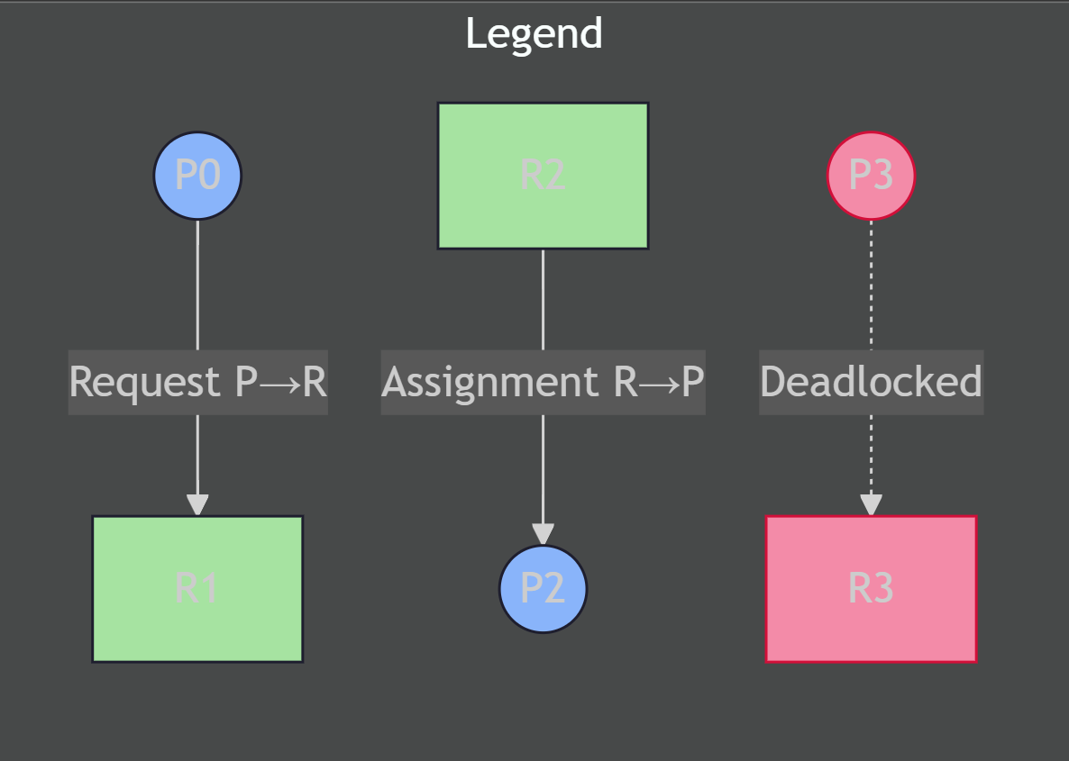
Resource Allocation Graph (RAG)
Live visual rendered with Qt's QPainter — updates on every detection run
RAG Example
P0
RAGWidget (Qt)
Custom QWidget subclass
Uses QPainter::Antialiasing
Circles = Processes
Squares = Resources
Deadlocked nodes in red
Auto-layout by column
Redraws on every detection
P1
P2

Slide 9
Recovery Strategies
Two strategies implemented — terminate all or terminate one at a time
Strategy 1: Terminate ALL
Strategy 2: Terminate ONE
for pid in deadlockedProcesses:
for r in 0..numResources:
available[r] += alloc[pid][r]
alloc[pid][r] = 0
// All deadlocked processes terminated
// Resources fully reclaimed
// System can continue
victim = deadlockedProcesses[0]
// Lowest PID selected as victim
for r in 0..numResources:
available[r] += alloc[victim][r]
alloc[victim][r] = 0
// Re-run Detection to check if
// deadlock is resolved
Kills all deadlocked procs instantly
Maximum resource reclaim
Fastest resolution
High process loss (costly in real OS)
Kills one process (lowest PID)
Partial resource reclaim
Re-run detection after each step
Minimises collateral damage
Both strategies update the Available vector in-place and log a full resource release trace

Slide 10
GUI Walkthrough — 3-Tab Interface
Built with Qt5 Widgets — dark-themed, matrix-driven, with live graph rendering
Tab 1 — Banker's
Tab 2 — Detection
Tab 3 — Recovery
Set # processes & resources
Fill Max, Allocation matrices
Check Safe State button
Request Resources (by PID)
Need matrix auto-computed
Load Example (5P / 3R)
Enter Available, Alloc, Request
Run Detection button
Lists deadlocked processes
Live RAG renders beside log
Deadlocked nodes highlighted red
Load Example for quick demo
State passed from Detection tab
Terminate ALL deadlocked PIDs
Terminate ONE (lowest PID)
Full resource release log
Updated Available displayed
Clear log button

Slide 11
Key Code — C++ Implementation
Banker::isSafeState() — Safety Loop
Detection::detect() — Detection Loop
while (count < numProcesses) {
bool found = false;
for (int i = 0; i < numProcesses; i++) {
if (!finish[i]) {
bool ok = true;
for (int j=0;j<numResources;j++)
if (need[i][j] > work[j])
{ ok=false; break; }
if (ok) {
for(int j=0;j<numResources;j++)
work[j] += allocation[i][j];
finish[i] = true;
safeSeq.push_back(i);
count++; found = true;
}
}
}
if (!found) break;
}
bool found = true;
while (found) {
found = false;
for(int i=0;i<numProcesses;i++){
if (!finish[i]) {
bool ok = true;
for(int j=0;j<numResources;j++)
if(request[i][j]>work[j])
{ ok=false; break; }
if (ok) {
for(int j=0;j<numResources;j++)
work[j]+=allocation[i][j];
finish[i]=true;
found=true;
}
}
}
}
Key Difference:
Banker initialises Finish[i]=false for all; Detection uses Finish[i]=(Alloc[i]==0) — only blocks processes that actually hold resources

Slide 12
Conclusion & Learning Outcomes
Avoidance
Implemented Dijkstra's Banker's Algorithm with full safety-state analysis and request rollback
Detection
Built cycle-detection via resource-request graph traversal — identifies all deadlocked PIDs
Recovery
Two strategies: Terminate-All (fast) and Terminate-One (minimal disruption) with live resource reclaim
Visualisation
Custom QPainter RAGWidget renders live graph with color-coded deadlocked nodes and edges
Thank you — Questions? | NASTP IIT · BS Cyber Security · May 2026

